Slide 1
treatment of catheter-related bloodstream infection
Md.S.Kalantari

Slide 2
When can a catheter be retained until blood cultures are available?

Slide 3
Immediate removal of the CVC is not routinely recommended when CRBSI is suspected in patients who are hemodynamically stable, without immunosuppressive therapy, intravascular foreign bodies or organ transplantation, no suppuration at the insertion site or bacteremia/fungemia

Slide 4
When is it safe to perform a catheter exchange over a guidewire?

Slide 5
Routine replacement of a CVC by guidewire exchange is not recommended because this strategy is associated with a higher risk of associated infectious complications.

Slide 6
Guidewire exchange of a CVC is contraindicated in patients with documented catheter related infections.

Slide 7
Guidewire exchange should be restricted to patients with very difficult venous access (i.e., extensive burns, morbid obesity, or severe coagulopathy) and without documented catheter infection (B-II). In this case, a meticulous aseptic technique and a culture of the catheter tip are mandatory.

Slide 8
If the catheter tip culture is positive, the new line, inserted over a guidewire, should be re-placed via a new direct venipuncture.

Slide 9
Indications for catheter removal in patients with CRBSI
CRBSI presenting with septic shock
CRBSI caused by certain pathogens: S. aureus, non-fermenting Gram-negative bacilli, Candida spp. or Mycobacterium
Metastatic complications (endocarditis, thrombophlebitis or septic pulmonary embolism)
Bacteremia (or candidemia) persisting after 72 h of adequate treatment
Pus is observed at the insertion site
Signs of infection at the subcutaneous tunnel
No possibility of antibiotic lock therapy

Slide 10
What should be done if the catheter tip culture is positive, but the blood cultures are negative?

Slide 11
Antibiotic treatment (i.e., 5---7 days) should be given to patients with catheter tip cultures positive for S. aureus and negative blood cultures if the patient shows systemic or local infection

Slide 12
In non-neutropenic patients or those without valvular heart disease, the presence of a catheter tip culture positive for Candida spp. and negative or unavailable blood cultures should be assessed on an individual basis before starting systematic antifungal treatment. Antifungal treatment should not be prescribed for patients without systemic signs of infection

Slide 13
No clear recommendations can be given for catheters colonized with other microorganisms.

Slide 14
Empirical antimicrobial therapy
If CRBSI is suspected, antimicrobial therapy should be started as soon as possible with a bactericidal agent active against S. aureus and CoNS, especially if associated with sepsis or septic shock
Vancomycin is recommended for empirical therapy in patients with suspected CRBSI (B-II). Teicoplanin is not recommended as empirical therapy, given the existence of coagulase-negative staphylococci with reduced susceptibility to teicoplanin.

Slide 15
Daptomycin can be administered for cases of CRBSI with septic shock (C-III), acute kidney injury (B-III), to patients with recent exposure to vancomycin (>1 week in the past 3 months) (C-III) or if the local prevalence of S. aureus isolates with vancomycin MIC ≥1.5mg/ml is high (C-III).
Linezolid should only be used in patients with contraindications for the previous agents (B-II).

Slide 16
When should empirical coverage of Gram-negative bacilli or fungi be added?

Slide 17
Patients with suspected CRBSI should receive empirical antibiotic therapy (in addition to coverage for Gram-positive pathogens) to cover Gram-negative bacilli under any of the following circumstances: hemodynamic instability (septic shock), neutropenia or hematologic malignancy, solid organ or bone marrow transplant, femoral catheter in place, a high index of colonization with Gram-negative bacilli or prolonged ICU admission (C-III).

Slide 18
Antimicrobial therapy should be adapted to local epidemiology and must include an antipseudomonal agent (i.e., piperacillin-tazobactam, carbapenems, a fourthgeneration cephalosporin, aztreonam, quinolones or aminoglycosides) (A-II).

Slide 19
The need for empirical antifungal therapy in a patient with suspected catheter-related candidemia should be evaluated along with the possibility of catheter removal (A-III).
Empirical therapy for suspected catheter-related candidemia should be considered in patients who are hemodynamically unstable with one or more of the following conditions: total parenteral nutrition, prolonged use of broad-spectrum antibiotics, malignancy, femoral catheterization, colonization due to Candida spp. at multiple sites or intense previous anti-anaerobic therapy (C-III).

Slide 20
The use of biomarkers (such as 1,3-B-D-glucan) may be useful when considering initiation of empirical antifungal treatment (B-III).

Slide 21
Confirmed CRBSI

Slide 22
Coagulase-Negative
Staphylococcus
With the exception of Staphylococcus lugdunensis,which should be managed as for Staphylococcus aureus.
Consider catheter removal(if not done):
Catheter must be removed in patients with septic shock secondary to CRBSI or in patients with intravascular devices.
Antimicrobial therapy for 5 days (In patients with intravascular devices, foreign bodies (such as articular prostheses) or in whom markers of inflammation persist after catheter removal therapy, antibiotic therapy for 10---14 days is recommended)
Vancomycin is the first option
Echocardiography is not mandatory

Slide 23
Catheter retained:
Antimicrobial therapy for 10 -14 days
Vancomycin is the first option
ALT with vancomycin for 10-14 days
Echocardiography is not mandatory(Echocardiography should be done in patients with valvular diseases or in case of persistent bacteremia despite appropriate therapy.)

Slide 24
Staphylococcus aureus
Removal of the catheter is mandatory
Antimicrobial therapy for 14 days (Complicated episodes require longer courses of treatment (4---6 weeks).)
Cloxacillin or cefazolin are the alternatives for MSSA
Vancomycin or daptomycin are the alternatives for MRSA (Trough levels of vancomycin should be 15---20 mg/l. Daptomycin is preferred for isolates with MIC for vancomycin >1.5 mg/l.)
Echocardiography is mandatory

Slide 25
Enterococcus spp.
Removal of the catheter is mandatory
Antimicrobial therapy for 7-14 days
Ampicillin is the drug of choice for susceptible strains (Combined therapy with an aminoglycoside is discouraged for Enterococcus spp. CRBSI.)
Vancomycin is the alternative for strains resistant to ampicillin (Optimal trough levels of vancomycin for Enterococcus spp. CRBSI are not defined.)
Echocardiography is mandatory

Slide 26
Gram-negative bacilli
Remove the catheter (if not done)
Antimicrobial therapy for at least 7 days
Antimicrobial therapy must be chosen based on the susceptibility results
Echocardiography is not mandatory

Slide 27
Catheter retained (Only in immunocompetent patients without septic shock and when the isolate is susceptible to antibiotics that are available for ALT.)
Antimicrobial therapy for 10-14 days
Antimicrobial therapy must be chosen based on the susceptibility results
ALT for 10-14 days
Echocardiography is not mandatory

Slide 28
Candida spp.
Removal of the catheter is mandatory
Antifungal therapy for 14 days after the first negative blood culture (If metastatic complications have been ruled out)
Targeted antifungal therapy must be chosen based on the susceptibility results (De-escalation from an echinocandin or a lipid formulation of amphotericin B to fluconazole is highly recommended in patients with isolates susceptible to fluconazole, are clinically stable and the catheter has been removed.)
Echocardiography is mandatory

Slide 29
Antibiotic Lock Therapy (ALT)

Slide 30
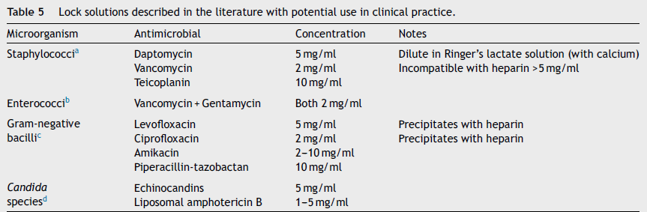

Slide 31
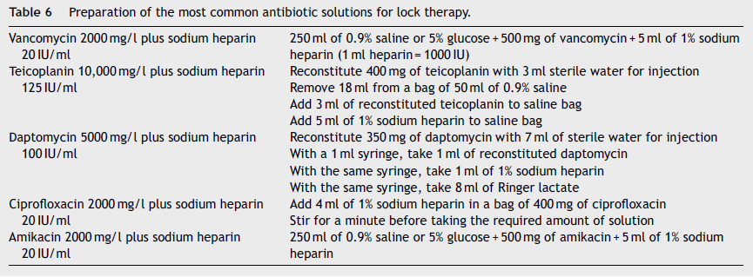

Slide 32
thanks for your attention

